Slide 1

Big Data Storage and Processing MSc in Data Analytics CCT College Dublin
Revision BDSP
Week 13
Lecturer: Dr. Muhammad Iqbal*
Email: miqbal@cct.ie
©CCT College Dublin 2022

Slide 2
Agenda
Hadoop
Map-Reduce Programming Model
Apache HBase
Apache Spark
Apache Pig
NOSQL Cassandra database
YCSB & MongoDB
Apache HIVE
Graph Database
Kafka Streaming

Slide 3
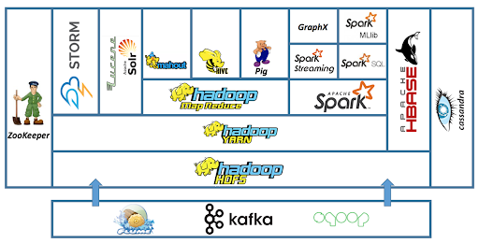
Hadoop Ecosystem
Hadoop Ecosystem is a platform which provides various services to solve the big data problems. It includes Apache projects and various commercial tools and solutions.
New Approach
Google
Amazon
Scalable Storage and Processing platforms based on commodity hardware
Implemented as an open-source Apache Hadoop project
The Hadoop Ecosystem
HDFS: Hadoop Distributed File System
YARN: Yet Another Resource Negotiator
MapReduce: Programming based Data Processing
Spark: In-Memory data processing
PIG, HIVE: Query based processing of data services
HBase: NoSQL Database
Mahout, Spark MLLib: Machine Learning algorithm libraries
Zookeeper: Managing cluster
Oozie: Job Scheduling
Notes:
Hadoop is difficult to program as it uses Java for data absorption.

Slide 4
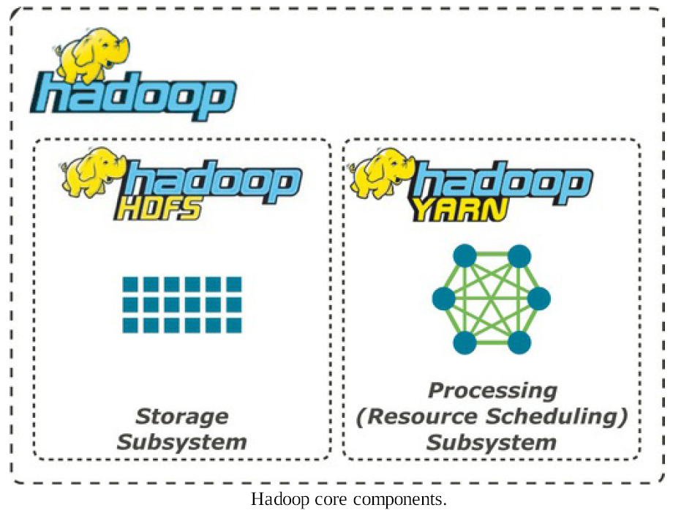
Big Data and HDFS
Scalable Storage and Processing platforms based on commodity hardware
HDFS – Hadoop Distributed File System
MapReduce is a programming model
Storage of arbitrary data
Semi-structured
Unstructured
Data interpreted at analysis stage
Allows for re-classification of data based on chosen algorithms as a part of analyses
Optimised for large file storage
Batch-oriented
Supports streaming access to data
Designed to answer the question: “How to process big data with reasonable cost and time?”
Why the industry need Hadoop?
Big data brings with it two fundamental challenges
How to store and work with voluminous data sizes?
How to understand data and turn it into a competitive advantage?
Hadoop can do both tasks.

Slide 5
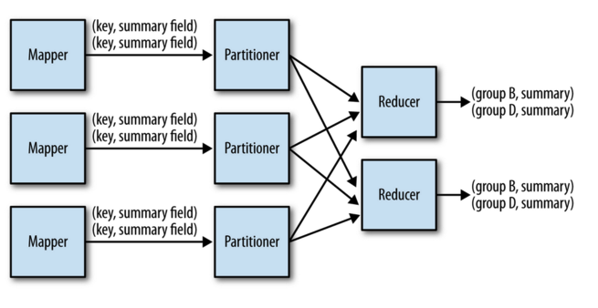
MapReduce Design Patterns
Categorization of Map-Reduce Patterns
Summarization
Filtering
Join
Data Organization
Input / Output

Slide 6
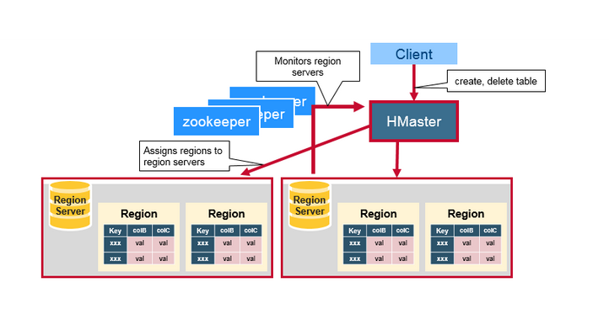
Apache HBase
HBase is a Java-based, open-source, non-relational distributed database that is based on Google's Bigtable.
It is created as a component of the Apache Hadoop project and runs on top of HDFS or Alluxio, giving Hadoop capabilities similar to those of Bigtable.
The master is responsible for assigning regions to region servers and uses Apache Zookeeper
Reliable, highly available, persistent, distributed coordination service
Necessary component for HBase operation
Notes:
ZooKeeper is a centralized service for maintaining configuration information, naming, providing distributed synchronization, and providing group services. All of these kinds of services are used in some form or another by distributed applications.

Slide 7
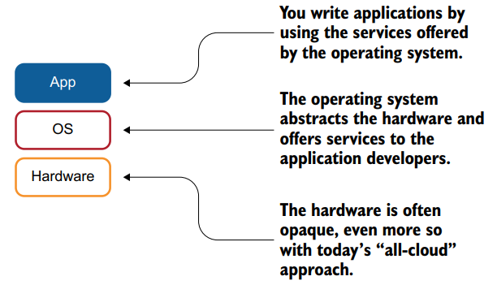
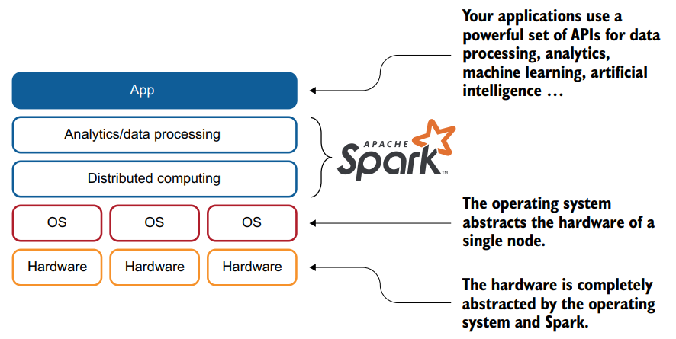
Apache Spark
Apache Spark is a software stack for data scientists. When you build applications, you build them on top of an operating system as illustrated in the figure.
The operating system provides services to make your application development easier; in other words, you are not building a filesystem or network driver for each application you develop.
Apache Spark simplifies the development of analytics-oriented applications by offering services to applications as an operating system does.

Slide 8
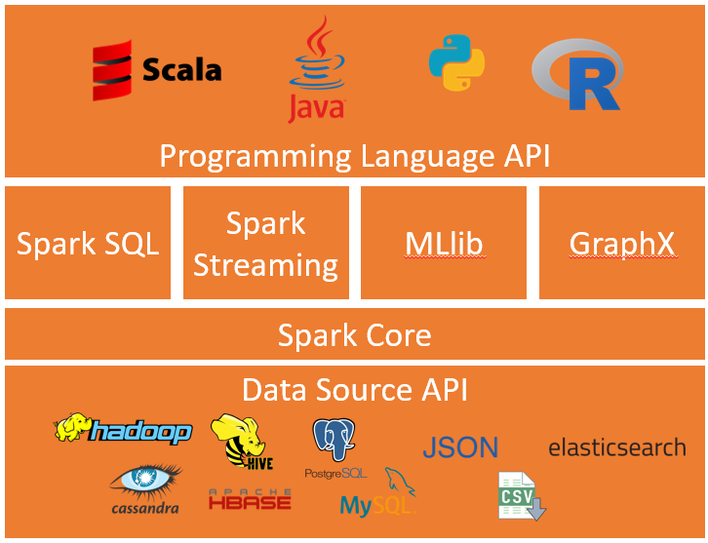
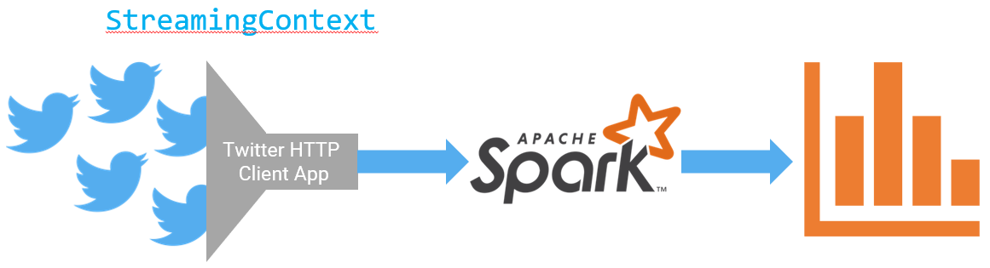
Apache Spark
Data is generated continuously from one or many sources
Sources can send the data simultaneously
Data comes in small packages (kilobyte scale) in succession
A lot of applications use continuously-updated data
Examples
Sensors in vehicles, industrial equipment, and machinery send data to streaming for performance measurement.
Solar power company monitoring panel performance through streaming
Online gaming company collecting streaming data about player-game interactions
Spark streaming can use it to track most popular hashtags in 5 mins windows based on their counts in a Twitter stream, and by using the StreamingContext function.

Slide 9
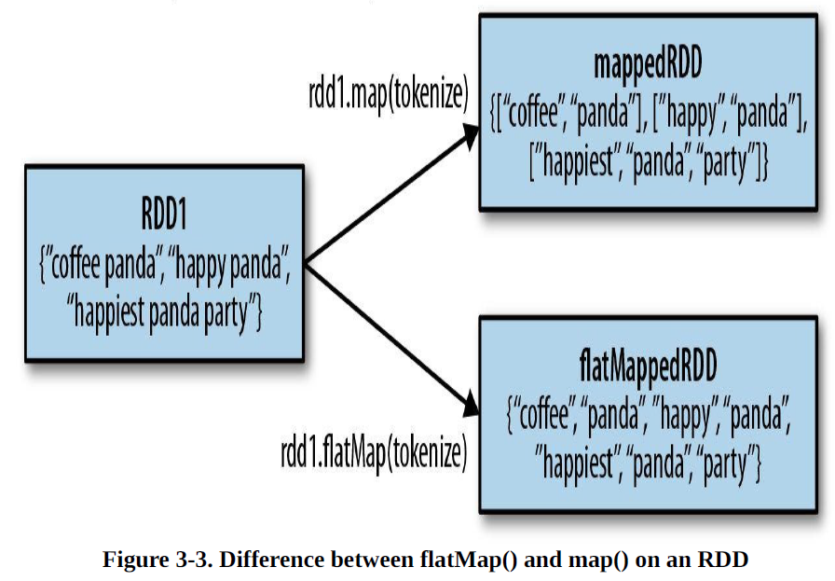
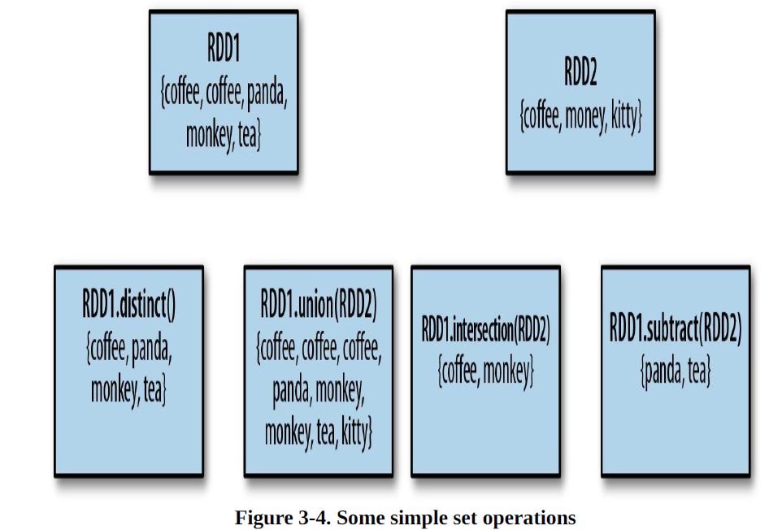
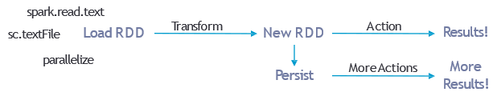
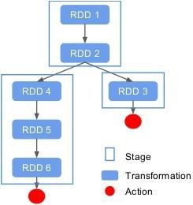
Spark Programming Model
Transformations
.filter(function)
.distinct()
.first()
.union()
.map(function)
.flatMap(function)
Actions
.reduce()
.count()
.persist()
.collect()
.saveAsTextFile()
.saveAsSequenceFile()
Notes:
Map and Reduce functions in Spark to not directly correspond
Map – takes one row and results in one row (transformation)
FlatMap – takes one row and results in 0 – several rows (transformation)
Reduce – performs specified function on data, e.g. add values (action)
ReduceByKey – works with key-value pairs to calculate and group (transformation)

Slide 10
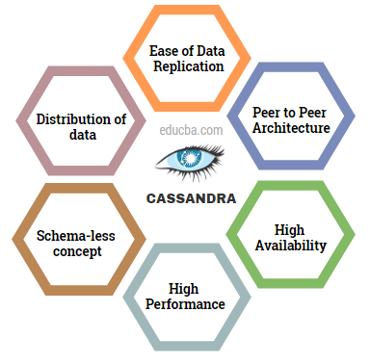
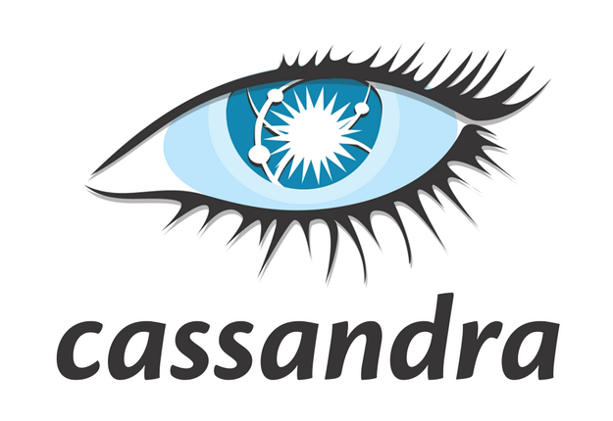
Apache Cassandra
The Apache Cassandra data storage system differs greatly from a relational database management system in many ways.
Apache Cassandra is an open source, distributed, decentralized, elastically scalable, highly available, fault-tolerant, tuneable consistent, column-oriented database that bases its distribution design on Amazon’s Dynamo and its data model on Google’s Bigtable.
Created at Facebook and it is used at some of the most popular sites on the Web.
In addition to performing blazingly fast writes, it can store hundreds of terabytes of data, and it is decentralized and symmetrical, so the failure point is eliminated. It provides schema-free data models and is highly available.
Cassandra's interface allows it to be accessed from a variety of languages, including C#, Scala, Python, and Ruby.
Notes:
Also called Alexandra. Classical Mythology. a daughter of Priam and Hecuba, a prophet cursed by Apollo so that her prophecies, though true, were fated never to be believed.
a person who prophesies doom or disaster.
a female given name: from a Greek word meaning “helper of men.”

Slide 11
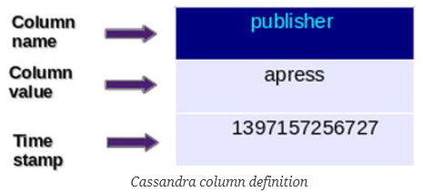
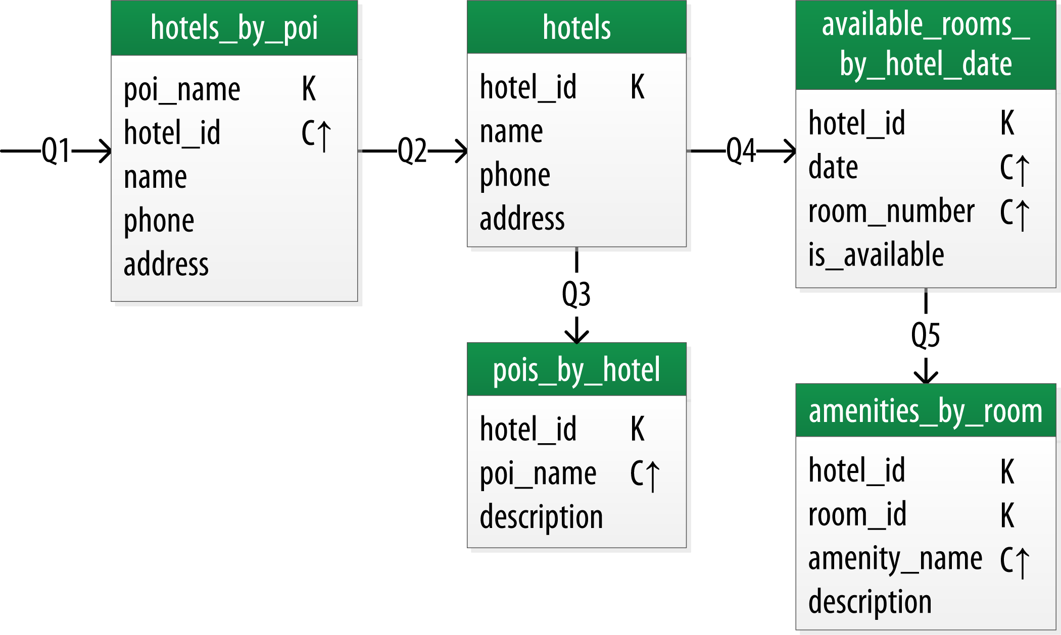
Data Models Rules in Cassandra
Cassandra doesn't support JOINS, GROUP BY, OR clause, aggregation etc. You have to make sure the data is stored in a way that it can be accessed at any time.
Cassandra is optimized for high write performances so you should maximize your writes for better read performance and data availability. There is a tradeoff between data write and data read. So optimize your data read performance by maximizing the number of data writes.
Maximize data duplication because Cassandra is a distributed database and data duplication provides instant availability without a single point of failure.
Q1. Find hotels near a given point of interest.
Q2. Find information about a given hotel, such as its name and location.
Q3. Find points of interest near a given hotel.
Q4. Find an available room in a given date range.
Q5. Find the rate and amenities for a room.

Slide 12
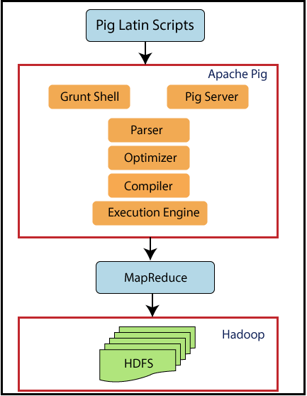
Apache Pig
Pig is a client application
Requirement of a cluster is not essential
Interprets Pig Latin scripts to MapReduce jobs
Parses Pig Latin scripts
Performs optimization
Performs compilation
Creates execution plan
Submits MapReduce jobs to the hdfs cluster
Notes:
To parse, in computer science, is where a string of commands – usually a program – is separated into more easily processed components, which are analyzed for correct syntax and then attached to tags that define each component. The computer can then process each program chunk and transform it into machine language.

Slide 13
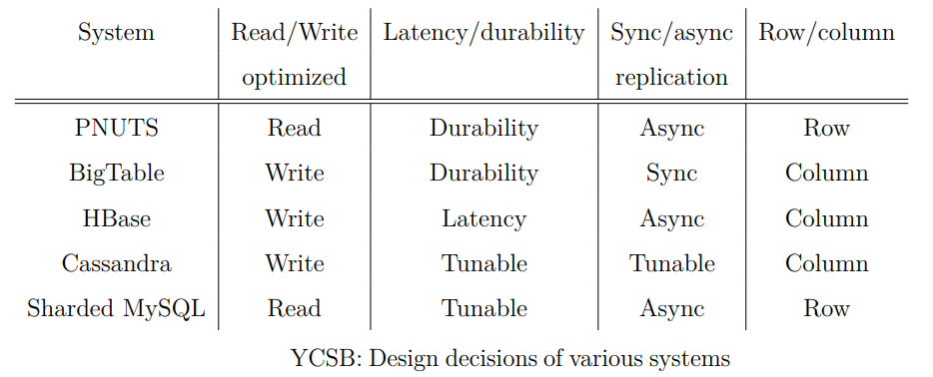
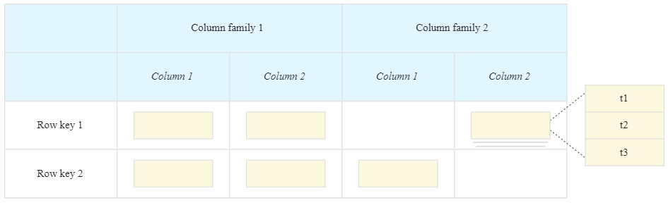
Yahoo Cloud Serving Benchmark YCSB
Most NoSQL databases make trade-offs like optimising for reads vs. writes, latency vs. durability, and synchronous vs. asynchronous replication, among others.
The workloads they created for YCSB were created to "directly explore these trade-offs."
These trade-offs are shown in Table below for a small number of databases.
BigTable (Google) is designed for quick writes, long-term durability, and synchronous replication. It has a column-oriented data model.
https://cloud.google.com/bigtable/docs/overview

Slide 14

MongoDB
MongoDB is a powerful, flexible, and scalable general-purpose database.
MongoDB has the ability to scale out with features such as secondary indexes, range queries, sorting, aggregations, and geospatial indexes.
User-Friendliness
MongoDB is a document-oriented database, not a relational one. The primary reason for moving away from the relational model is to make scaling out easier, but there are some other advantages as well.
The concept of a "row" is replaced by a more flexible model called "document" in a document-oriented database, like MongoDB.
MongoDB allows complicated hierarchical relationships to be represented with just a single record by allowing embedded documents and arrays. This is how current object-oriented language developers think about their data.
Notes:
There are also no predefined schemas: a document’s keys and values are not of fixed types or sizes. Without a fixed schema, adding or removing fields as needed becomes easier. Generally, this makes development faster as developers can quickly iterate. It is also easier to experiment. Developers can try dozens of models for the data and then choose the best one to pursue.

Slide 15
Apache Hive
Developed by Facebook and a top-level Apache project.
A data warehousing infrastructure based on Hadoop.
Immediately makes data on a cluster available to non-Java programmers via SQL like queries.
Built on HiveQL (HQL), a SQL-like query language.
Interprets HiveQL and generates MapReduce jobs that run on the cluster.
Enables easy data summarization, ad-hoc reporting and querying, and analysis of large volumes of data.

Slide 16
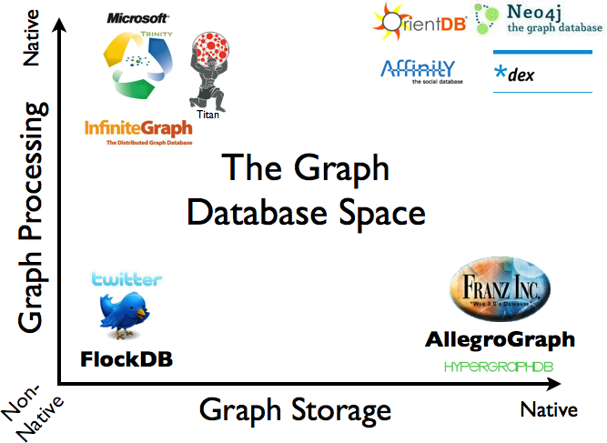
Graph Databases
Graph data model treats relationships as first-class citizens.
As compared to other DBMSs, we have to infer connections between entities using things like foreign keys or out-of-band processing such as map-reduce.
By assembling the simple abstractions of nodes and relationships into connected structures, graph databases enable us to build sophisticated models that map closely to our problem domain.
The resulting models are simpler and at the same time more expressive than those produced using traditional relational databases and the other NOSQL (Not Only SQL) stores.
Figure shows a pictorial overview of some of the graph databases on the market today, based on their storage and processing models.

Slide 17
Kafka Streaming
A client library called Kafka Streams is used to create apps and microservices whose input and output data are stored in Kafka clusters.
It combines the advantages of Kafka's server-side cluster technology with the ease of creating and deploying regular Java and Scala apps on the client side.
Kafka Streams Use Cases
The New York Times uses Apache Kafka and the Kafka Streams to store and distribute, in real-time, published content to the various applications and systems that make it available to the readers.
As of 2017, trivago offer access to approximately 1.8 million hotels and other accommodations in over 190 countries. trivago uses Kafka, Kafka Connect, and Kafka Streams to enable our developers to access data freely in the company. Kafka Streams powers parts of our analytics pipeline and delivers endless options to explore and operate on the data sources we have at hand.
Rabobank is one of the 3rd largest banks in the Netherlands. Its digital nervous system, the Business Event Bus, is powered by Apache Kafka. It is used by an increasing amount of financial processes and services, one of which is Rabo Alerts. This service alerts customers in real-time upon financial events and is built using Kafka Streams.

Slide 18
Resources/ References
G. Somasundaram, A Shrivastava (Editors), 2009, Information Storage and Management: Storing, Managing, and Protecting Digital Information, Wiley Publishing
Tate, J. et al, (2012). Introduction to Storage Area Networks and System Networking. IBM.
Some images are used from Google search repository (https://www.google.ie/search) to enhance the level of learning.
https://kafka.apache.org/documentation/streams/
Copyright Notice The following material has been communicated to you by or on behalf of CCT College Dublin in accordance with the Copyright and Related Rights Act 2000 (the Act). The material may be subject to copyright under the Act and any further reproduction, communication or distribution of this material must be in accordance with the Act. Do not remove this notice

